Slide 1
WORKPLACE EXPOSURE ASSESSMENT AND FIELD MONITORING STRATEGIES
Eduardo J Salazar-Vega, MPH CPH
Jan Koehn, MS CIH

Slide 2
BASIC ELEMENTS
Industrial Hygiene (IH) is that science devoted to the anticipation, recognition, measurement, evaluation, and control of adverse stresses or agents which could cause sickness and impaired health among workers and the community. The basic goal of IH is to promote a safe and healthful work environment.

Slide 3
INDUSTRIAL HYGIENE
Anticipation
Recognition
Evaluation
Control

Slide 4
EXPOSURE ASSESSMENT SYSTEM
Integrated with other systems for defining, prioritizing, and managing worker health protection.

Slide 5
ASSESSMENT RESULTS
Used to determine the needs and priority for health hazard controls, build exposure histories, and demonstrate regulatory compliance.

Slide 6
EXPOSURE CHARACTERIZATION
State-of-the-art approach has shifted from compliance monitoring which focuses on the maximum-risk employee to determine whether exposures are above or below established limits, to comprehensive exposure assessment, which emphasizes characterization of all exposures for all workers on all days.

Slide 7
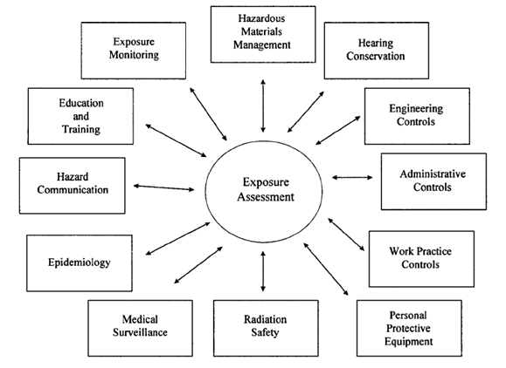

Slide 8
STRATEGY OVERVIEW
Basic Characterization
Exposure Assessment
Further Information Gathering
Health Hazard Control
Reassessment
Documentation

Slide 9
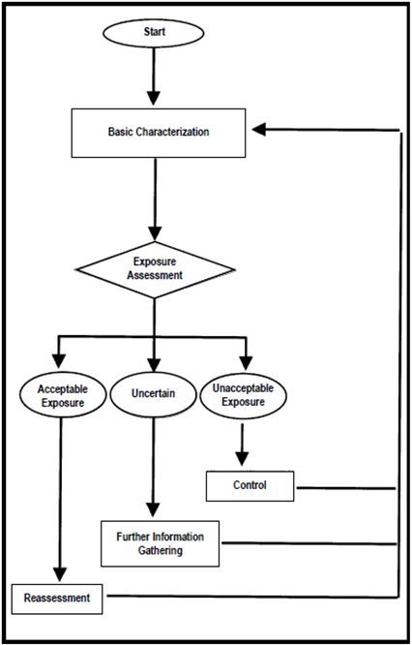

Slide 10
BASIC CHARACTERIZATION
Collect and organize information
Understand tasks being performed, materials used, process operations, and control measures
Develop exposure conditions

Slide 11
EXPOSURE ASSESSMENT
Define Similar Exposure Groups (SEGs)
Define exposure profiles
Determine acceptability of exposure profiles for each SEG

Slide 12
FURTHER INFORMATION GATHERING
Exposure Monitoring
Exposure Modeling
Biological Monitoring
Toxicological Data Generation
Epidemiological Data Generation

Slide 13
HEALTH HAZARD CONTROLS
Prioritized based on findings from exposure assessment
Diagnostic monitoring can be employed

Slide 14
REASSESSMENT
Updates on a timely basis
Comprehensive management-of-change process

Slide 15
DOCUMENTATION
Communication
Recommendations
Record Keeping

Slide 16
EXPOSURE ASSESSMENT GOALS
Comprehensive Strategy
Compliance Strategy
Limited, Specific Survey

Slide 17
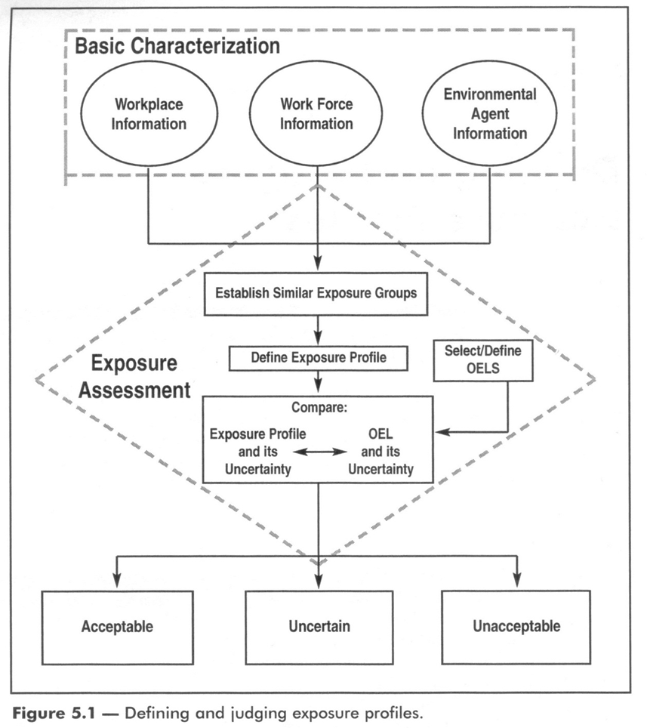

Slide 18
WALK-THROUGH SURVEY
Hazardous agents in workplace
Health effects associated with excessive exposures
OELs for each agent
Workforce organization and staffing
Significant sources of exposure; process separations and tasks and work procedures involved
Control measures

Slide 19
SOURCES OF INFORMATION
Facility tour and observations
Personnel interviews
Record reviews
Regulatory standards
Literature

Slide 20
ENVIRONMENTAL AGENTS
Type of agent
Use and properties
Routes of exposure
Potential health effects
Pertinent OELs

Slide 21
CATEGORIES OF AGENTS
Raw Materials
Intermediates
Products
Byproducts
Additives
Maintenance/construction Materials
Laboratory Chemicals
Hazardous Waste
Physical Agents
Biological Agents

Slide 23
SEGs DETERMINANTS
Process
Job
Task
Environmental Agent

Slide 24
EXPOSURE ASSESSMENT
Tiered, cyclic process
Qualitative/Quantitative
Level of uncertainty about specific level of exposure
OELs reference (10%)
Modeling

Slide 25
INITIAL ASSESSMENT
Qualitative
Data
Quantitative
Dara
Exposure Assessment

Slide 26
EXPOSURE SCENARIOS
Minor: if expected exposure is less than 1/10 OEL, if it is not likely to have an adverse effect to health, or if exposure does not create a regulatory issue.
Major: if expected exposure is equal or greater than 1/10 OEL, if it is likely to have an adverse effect to health, or if exposure creates a regulatory issue.

Slide 27
EXPOSURE RATINGS

Slide 28
EXPOSURE RATINGS
They can be defined based on::
Monitoring dataDatos de monitoreo
Personal sampling
Reference measures
Surrogate data
Data from exposure to other agents
Data from exposure to other operation/process
Modeling
Based on physical and chemical properties
Based on process’ information

Slide 29
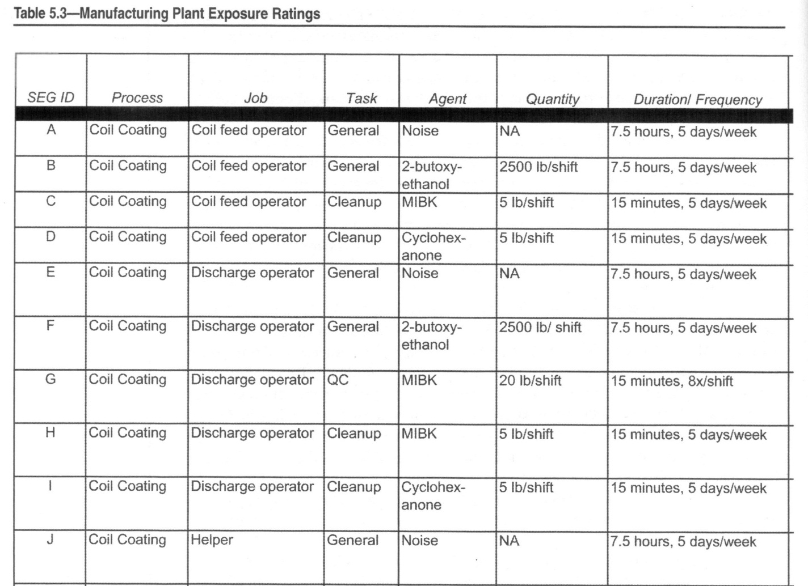

Slide 30
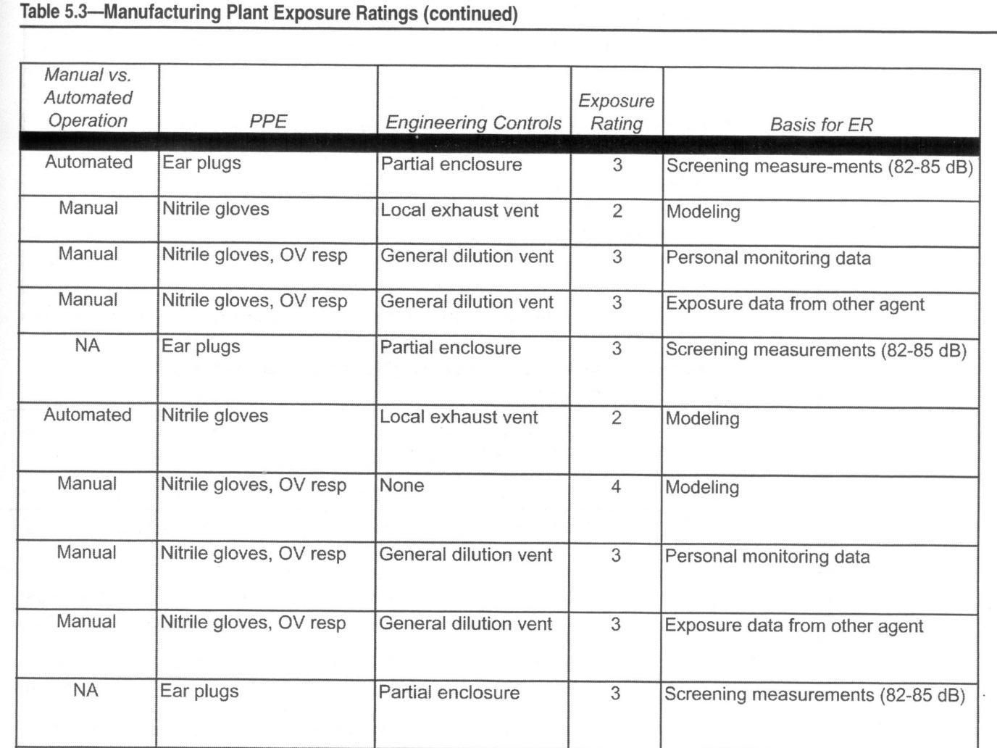

Slide 31
CHARACTERIZING THE EXPOSURE

Slide 32
CHARACTERIZING THE EXPOSURE

Slide 33
ACCEPTABLE EXPOSURES
Exposure and variability are low enough to create no more than the minimal risk associated with the exposure profile.
They might not need immediate action, but monitoring is performed to verify them.

Slide 34
UNACCEPTABLE EXPOSURES
They are easier to determine.
Exposure values are high enough, e.g. exceed the OEL
There is evidence of adverse health effects, e.g. a worker passed out as a consequence of a hot environment (heat stress)
If dermal contact is observed when the dermal route is an important route of exposure.

Slide 35
UNCERTAIN EXPOSURES
Exposure cannot be classified as acceptable nor unacceptable. There is no conclusion.
Few data
Many dermal exposures fall into this category.
It can be solved in two different ways
Collecting additional data.
Categorizing the exposure as unacceptable and controlling it.

Slide 36
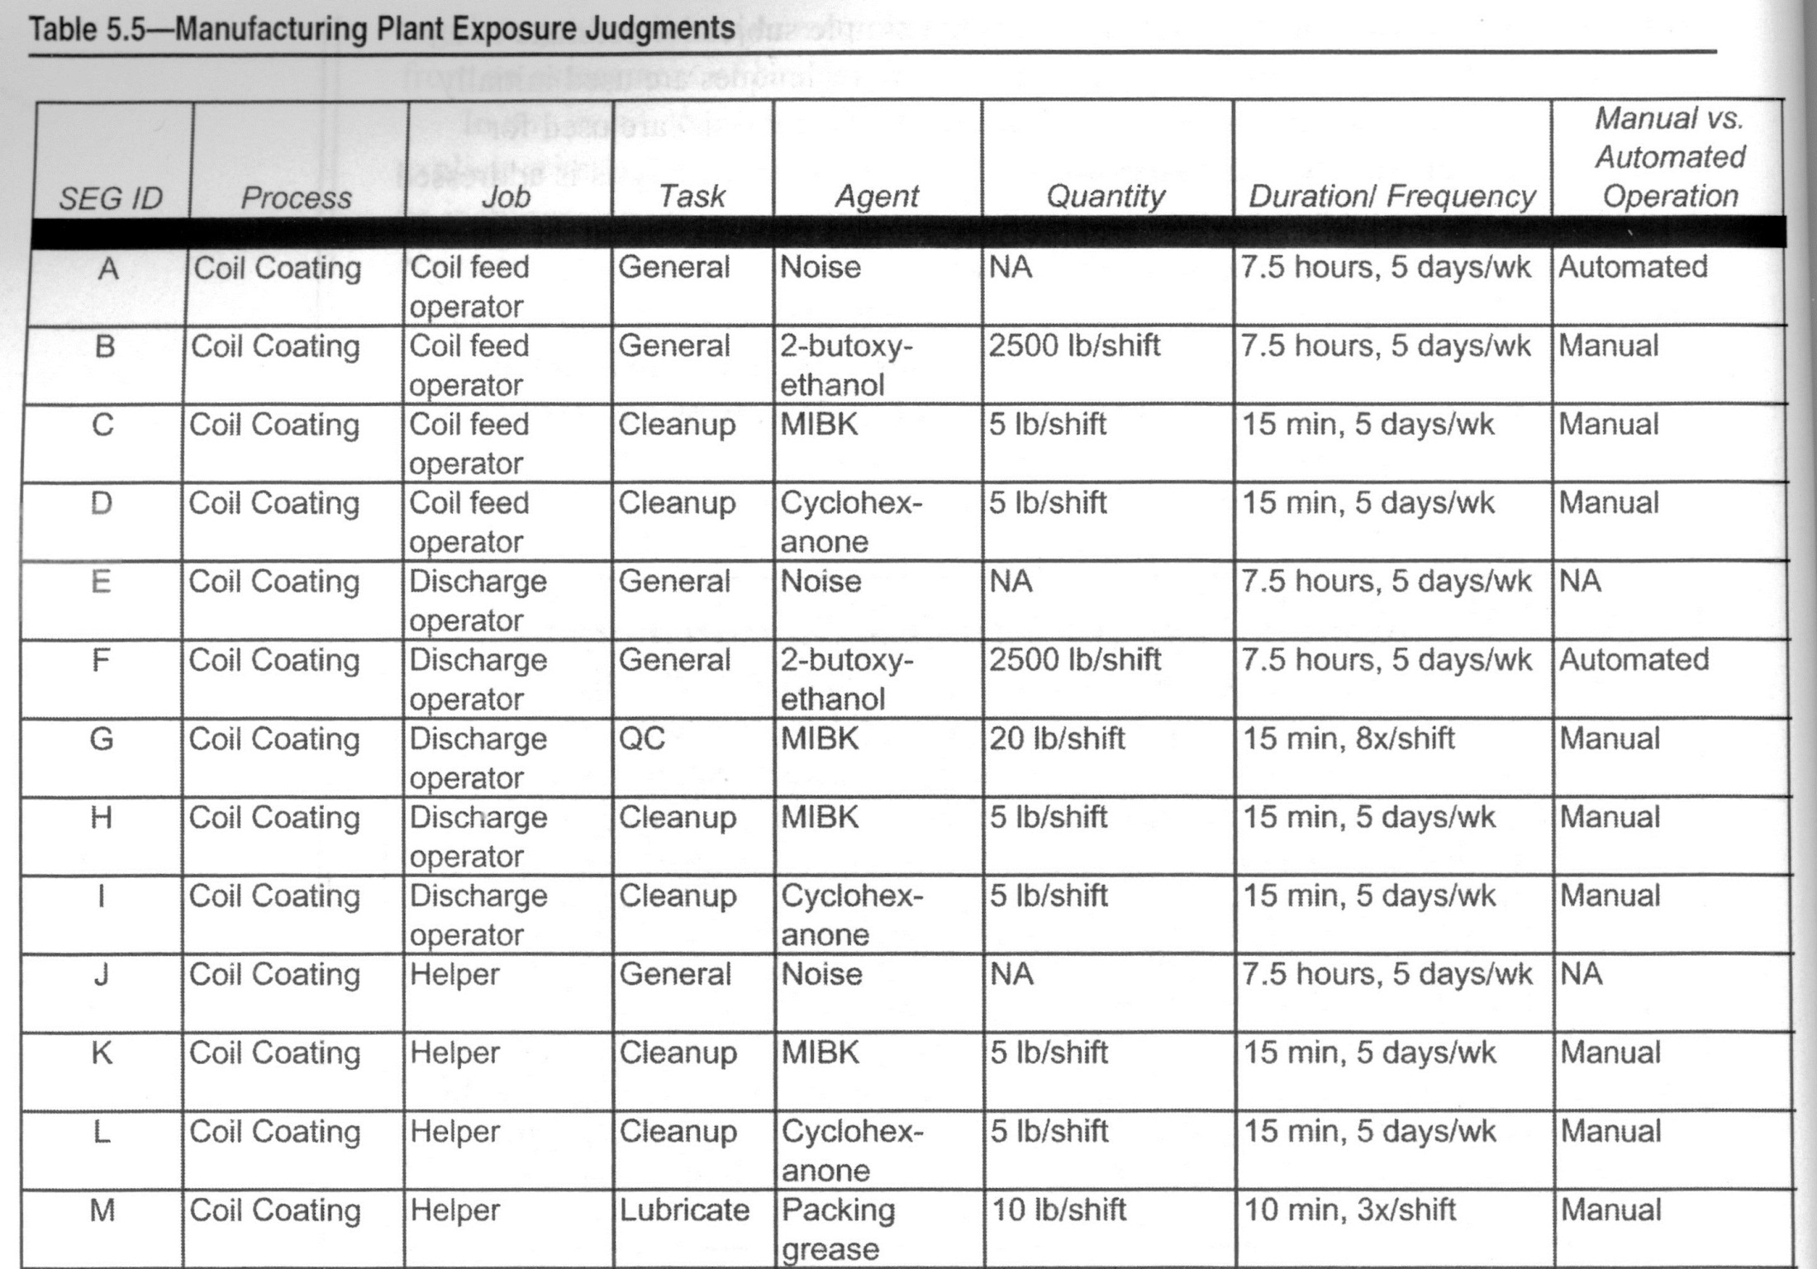

Slide 37
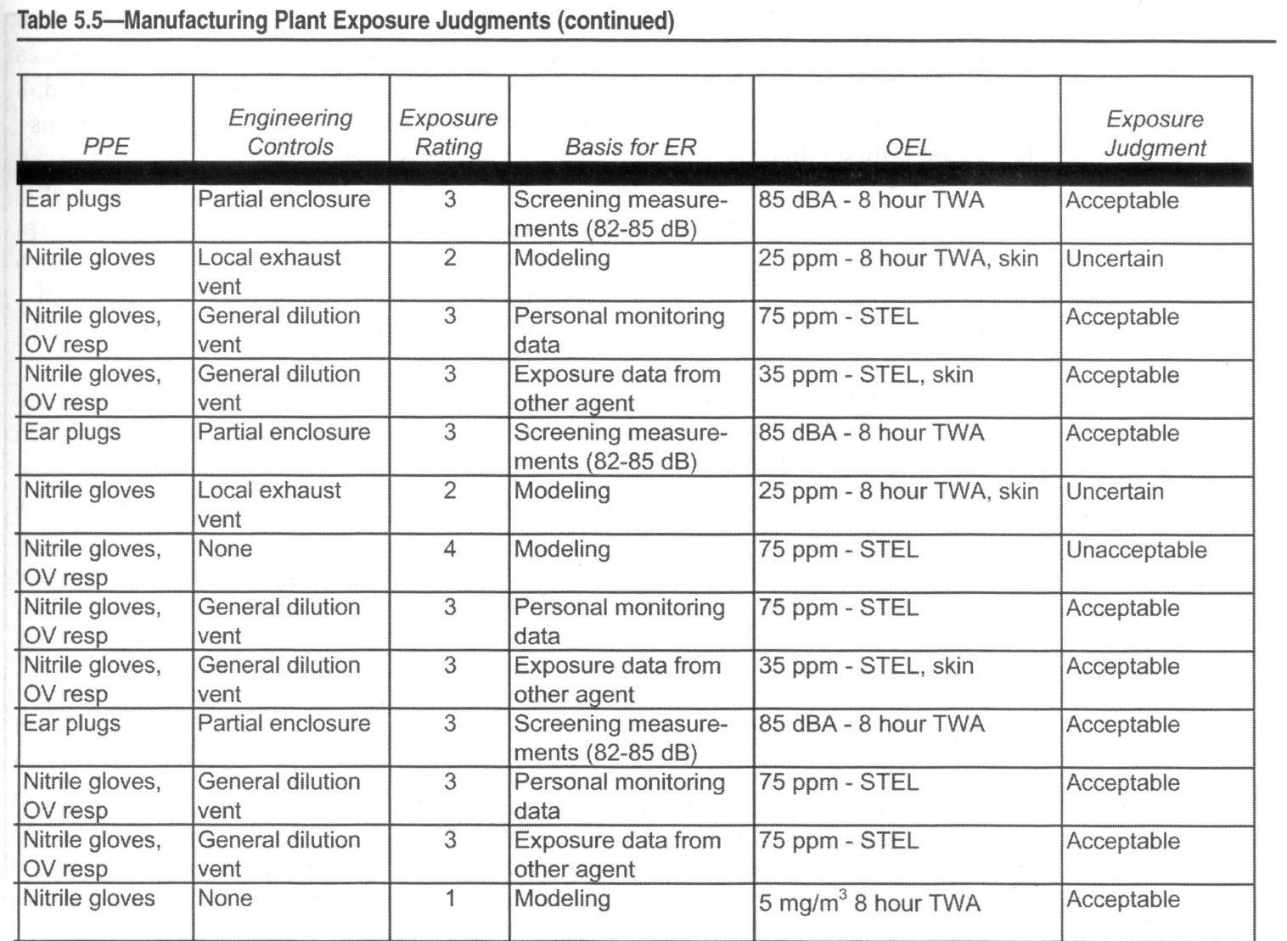

Slide 38
FURTHER INFORMATION GATHERING
Exposure profile
Judge acceptable at “10%of OEL”
Resolve uncertainties
Prioritization of SEGs

Slide 39
MONITORING
Measurement of exposure concentrations during a given time period. Monitoring data are used to help resolve, refine, or confirm the exposure assessment.

Slide 40
MONITORING OBJECTIONS
Baseline
Compliance
Diagnostic

Slide 41
EXPOSURE PATHWAYS
Inhalation
Ingestion
Skin or Eye Absorption

Slide 42
EXPOSURE MONITORING
Area
Personal
Averaging Times

Slide 43
OCCUPATIONAL EXPOSURE LIMITS
OSHA PELs
ACGIH TLVs
NIOSH RELs
AIHA WEELs

Slide 44
MONITORING PERIODS
Full-shift
8-hour Time Weighted Average
Short-Term Exposure Limits (STELs)
15-30 minute work tasks
Ceiling limits

Slide 45
SAMPLING STRATEGY DESIGN
Who
What
Where
When
Why
How Many
How Long
How to Sample

Slide 46
WHY QUESTION?
Regulatory Compliance
Corporate Requirement
Comprehensive Description
Establish Exposure Levels
Diagnostic Evaluation
Risk Assessment

Slide 47
WHAT QUESTION?
Everything?
Workplace Inventory
Exposure Assessment
Priority Ranking System

Slide 48
WHERE QUESTION?
Process Operations
Loading/Unloading Areas
Blending Locations
Maintenance/Repairs
Storage

Slide 49
WHEN QUESTION?
Multiple Shifts
Different Seasons
Variable Weather
Manufacturing Methodologies
e.g. cyclic, batch, continuous

Slide 50
WHO QUESTION?
Operations
Maintenance
Laboratory
Support
Transportation

Slide 51
HOW LONG QUESTION?
Full-shift
Partial Period
Short-term
Grab Samples
Others

Slide 52
HOW MANY QUESTION?
Potential Elevated Exposures
Representative
“Worst-case”

Slide 53
Questions?

Slide 54
SCENARIOS AND
APPLICATIONS

